Slide 1
Children types. Array as children, Function as children
by Taras Boichuk

Slide 2
What are children?
The children, in React, refer to the generic box whose contents are unknown until they’re passed from the parent component.
What does this mean?
It simply means that the component will display whatever is included in between the opening and closing tags while invoking the component. The component would usually be invoked from App component.

Slide 3
The power of children is that they can be anything.
The possible usage are:
Grouping unknown number of similar elements into a parent element.
You don’t know elements ahead of the time.
The nested structure that needs a wrapper.

Slide 4
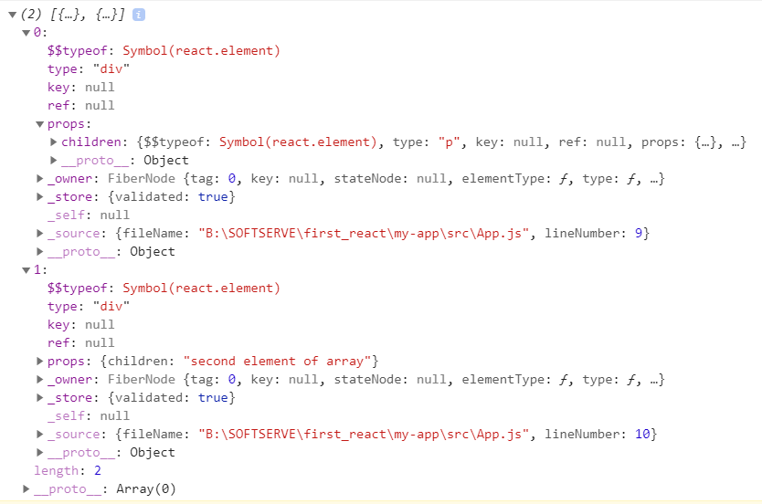
Children types
console.log(props.children)
In most cases it's either an array or a string.
function App() {
return (
<Componata>
<div>first element of array</div>
<div>second element of array</div>
</Componata>
);
}
function App() {
return (
<Componata>
This is string child
</Componata>);
}

Slide 5
Array as children
<Componata>
{[<div>first element of array</div>, <div>second element of array</div>]}
</Componata>
We use map() to create an array of React Elements for every value in the array.
<Componata>
{["first element of array", "first element of array"].map(item => (
<div>{item}</div>
))}
</Componata>

Slide 6
Function as children
React components don't support functions as children. However, render props is a pattern for creating components that take functions as children.

Slide 7

EXAMPLE
function App() {
return (
<div className='container'>
<Picture key={picture.id} src={picture.src}>
//what is placed here is passed as props.children
</Picture>
</div>
);
}
const Picture = (props) => {
return (
<div className='picture'>
<img src={props.src} className='picture'/>
</div>
)
}

Slide 8
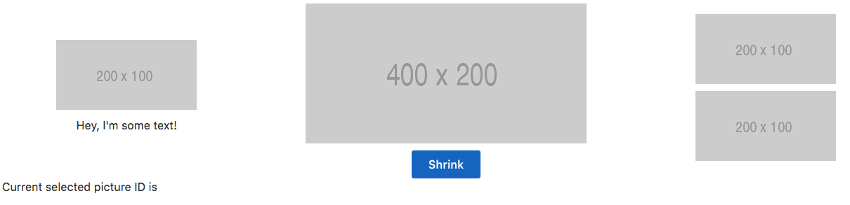


EXAMPLE
function App() {
return (
<div className="container">
<Picture src={this.state.pictures[0].src}>
<p>Hey, I'm some text!</p>
</Picture>
<Picture src={this.state.pictures[1].src}>
<Button pictureSrc={this.state.pictures[1].src}></Button>
</Picture>
<Picture src={this.state.pictures[2].src}>
<Picture src={this.state.pictures[2].src} />
</Picture>
</div>
);
}
const Picture = (props) => {
return (
<div className='picture'>
<img src={props.src} className='picture'/>
{props.children}
</div>
)
}

Slide 9
USED LINKS
https://reactpatterns.com/#array-as-children
https://zhenyong.github.io/react/tips/children-props-type.html
https://medium.com/javascript-in-plain-english/how-to-use-props-children-in-react-7d6ab5836c9d
https://codeburst.io/a-quick-intro-to-reacts-props-children-cb3d2fce4891
https://uk.reactjs.org/docs/composition-vs-inheritance.html

